Slide 1
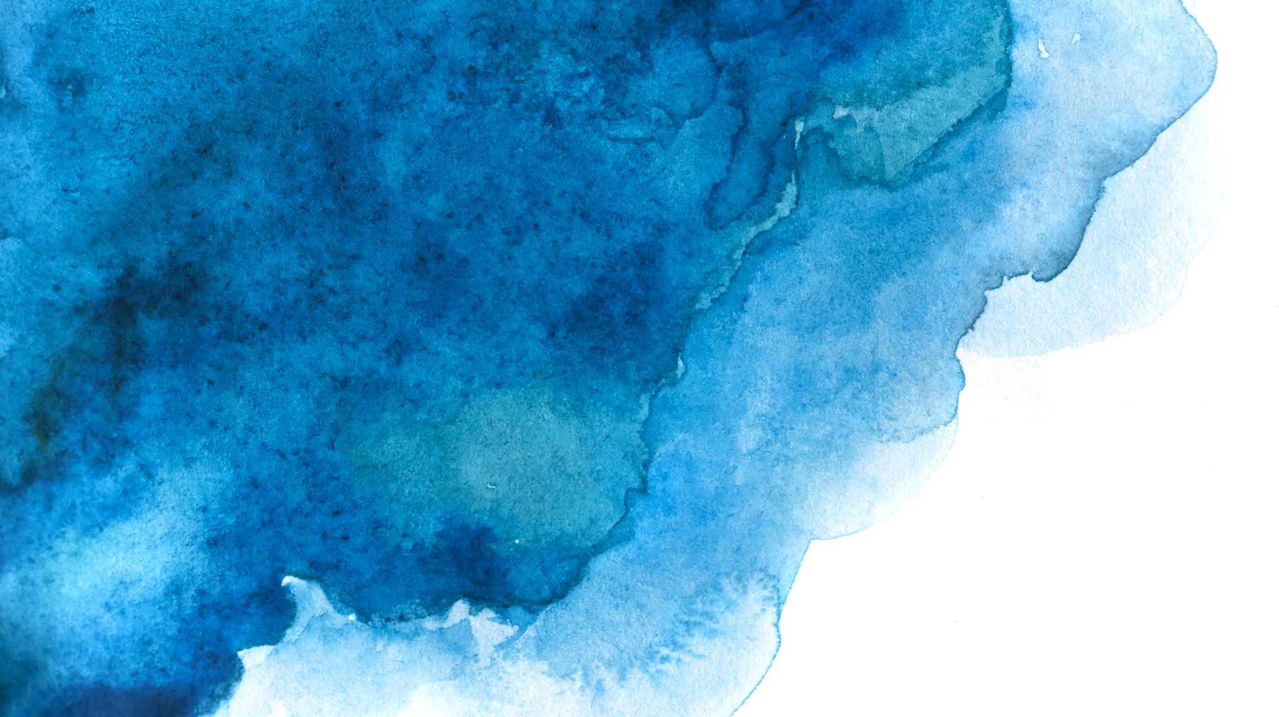
JRC Global Surface Water Datasets
Interdisciplinary Project
Muhammet Emir Gedikli 66065
İlayda Delioğlu 60205

Slide 2

1. Google Earth Engine (GEE)
🔹 What it is: A cloud-based geospatial analysis platform using satellite data. 🔹 What we did:
Chose JRC Global Surface Water v1.4 datasets (based on Landsat, 1984–2021).
Selected two datasets:
Mapping Layers → to analyze occurrence (0–100%) and change_abs (−50 to +50).
Occurrence (%) = shows how often each pixel was detected as water during 1984–2021.
Change_abs = difference between two epochs (1984– 1999 vs. 2000–2021).
Yearly Water Classification History → to create an annual water area time-series.
Provides annual data for each year from 1984 to 2021.
Drew the ROI polygon (Region of Interest) around Morskie Oko lake.
Ran analysis scripts to calculate:
Occurrence mean (≈91%)
Change_abs mean (≈ −4.7)
Permanent water area (occ ≥ 90%) (≈0.26 km²)
Annual water area (time series chart)

Slide 3
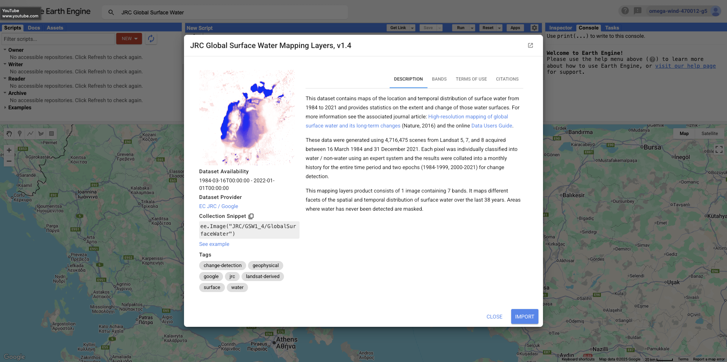
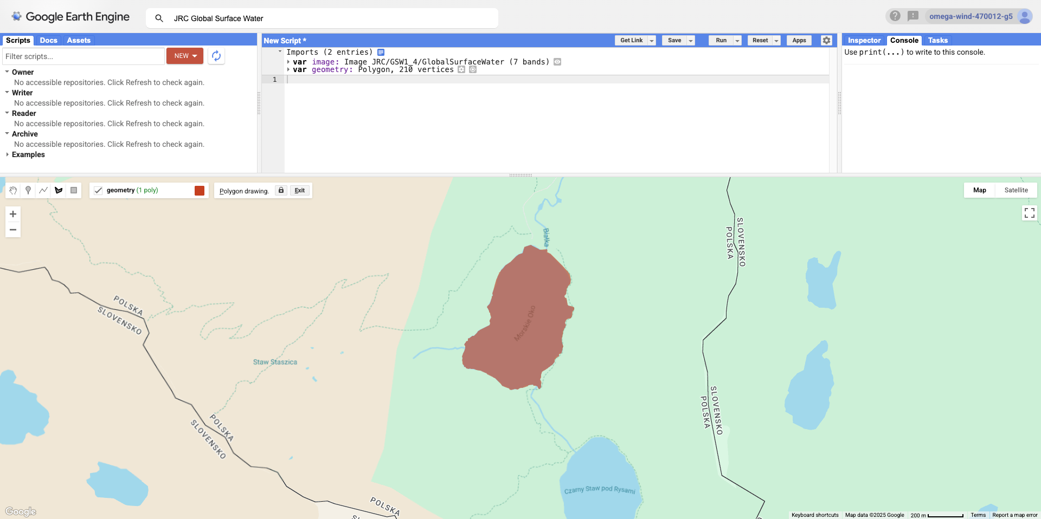
We combined Google Earth Engine (for satellite data processing) and QGIS (for cartographic visualization) to study surface water dynamics of Morskie Oko. Results show a stable, persistent water body with only minor shoreline variability.

Slide 4
2. QGIS (Desktop GIS software)
🔹 What it is: Open-source GIS for visualization, styling, and map export. 🔹 What we did:
Imported GeoTIFF rasters exported from GEE.
Applied custom Symbology:
Occurrence (0–100%) → color ramp (black–brown–yellow–cyan–blue).
ChangeAbs (−50 to +50) → color ramp (red–white–blue).
Used Print Layout to prepare maps with:
Legend (color explanation).
Scalebar (distance).
North arrow.
Title and labels.

Slide 5
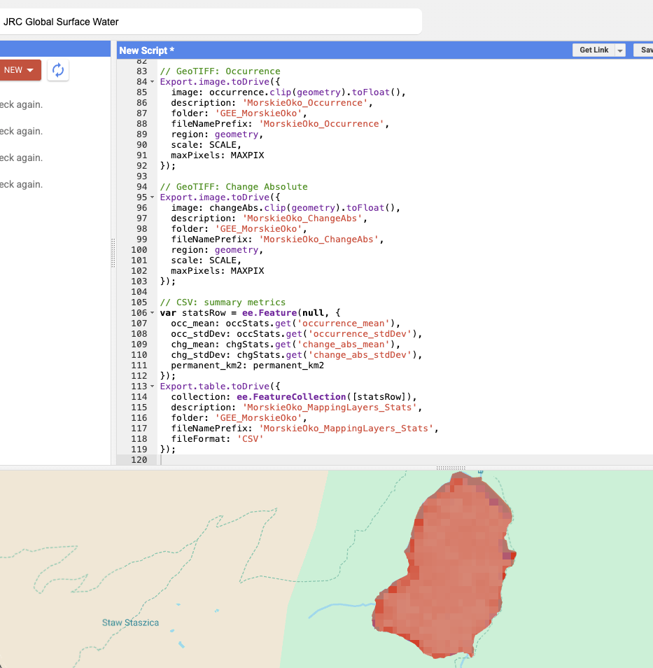
Occurrence Diagram:
occurrence_mean ≈ 91.4 → On average, pixels within lake polygon were water in ~91% of valid observations. Lake surface is almost always water between the years 1984–2021.
occurrence_stdDev ≈ 24.8 → There’s notable variability (stable center vs. dynamic shoreline/shallows).

Slide 6
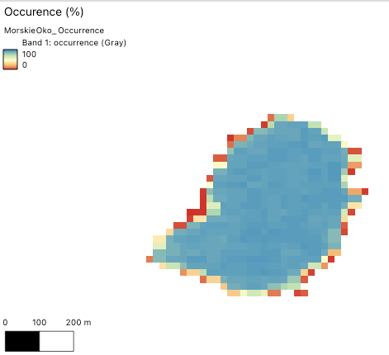
What “occurrence” is: For each pixel, it’s the percentage of valid satellite observations (since the mid-1980s) in which that pixel was classified as water.
Range: 0–100 (%).
High values (close to 100) = water is almost always present (persistent water).
Lower values = water is intermittent (shoreline, seasonal puddles) or often obscured (ice, cloud, shadow).
mean ≈ the average occurrence across your polygon (your lake footprint).
stdDev ≈ how variable occurrence is within the polygon (higher = more contrast between stable open water and dynamic edges).

Slide 7
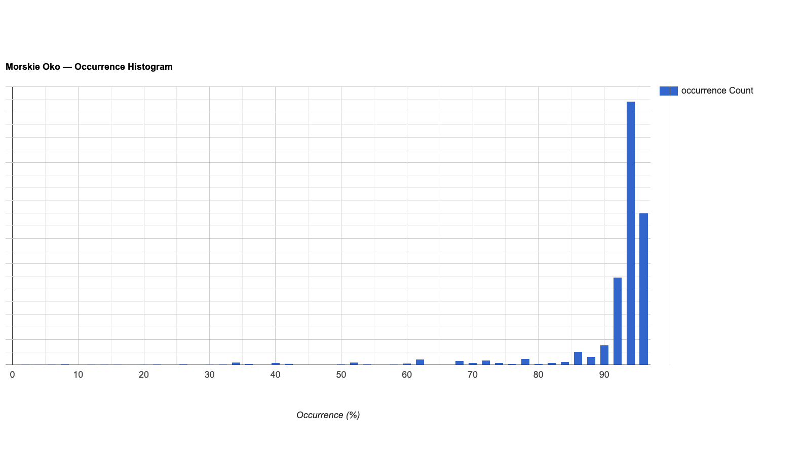
A dominant peak at ~100% confirms that most pixels are persistently water; lower-occurrence tails reflect edge pixels, seasonal ice/snow, and shadows.

Slide 8
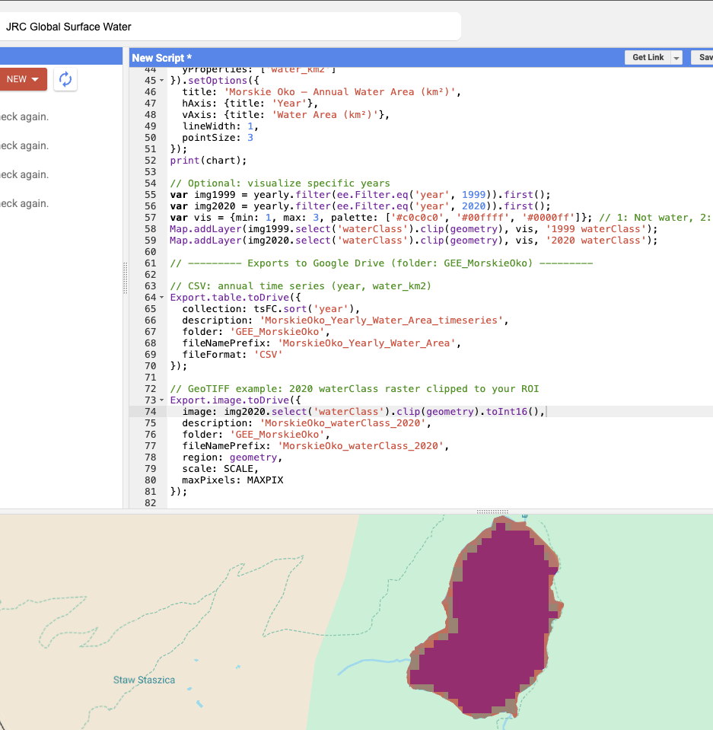
Change Abs Diagram:
change_abs_mean ≈ −4.75 → On average, pixels show a small decrease in how often they are detected as water in the later epoch vs. the earlier one (for a mountain lake this usually reflects shoreline shifts, winter ice/snow detection differences, or classification noise more than a true lake shrinkage).
In summary, very small negative change (mainly at shoreline).
change_abs_stdDev ≈ 8.34 → The change is not uniform; it clusters (likely around the shoreline).

Slide 9
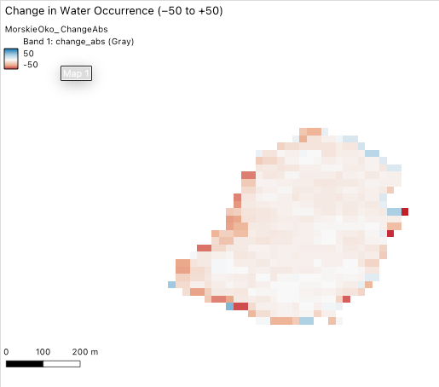
What “change_abs” is: The absolute change in water occurrence between two long periods (the dataset compares an earlier epoch to a later epoch).
Negative values → water occurrence decreased in the later period.
Positive values → water occurrence increased.
mean = average change across your polygon.
stdDev = spatial variability of that change where the change concentrates, typically along edges.

Slide 10
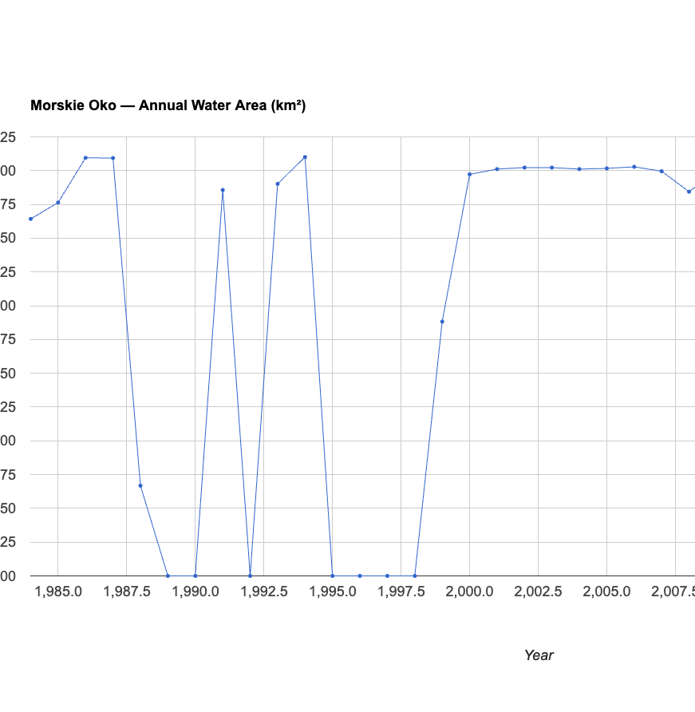
Stable around 0.29–0.31 km² after 2000.
Early gaps/drops (1980s–1990s) due to satellite data gaps/clouds, not real drying.
Conclusion: Morskie Oko is a persistent and stable mountain lake.

